Slide 1
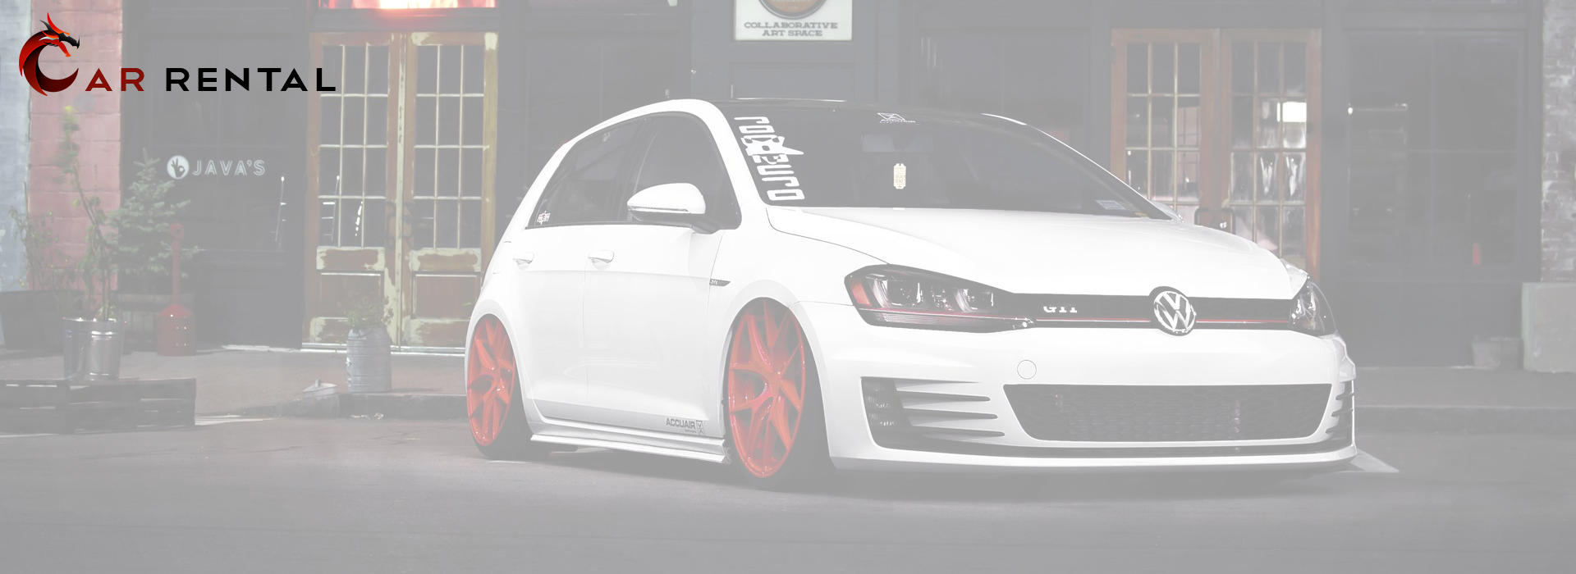
Cars for Hire, Don’t Commit
Developed By:
Anisha Paulose,
Cristy Jose,
Muhammad Ansheer,
Nandu S Nair,
Vishnu P S

Slide 2

Our Ambition
Build a network which can allow users to rent our car at any time and anywhere. Travel anywhere and may choose to return the car in that location. One of our service centers nearby will always be ready to receive you and the car.

Slide 3
What we did
Created a Erp system for a car renting service
It includes :
> A really fine ui with Login and Registration page for users
> A Database to store and manage user data credentials
> Pre-existing and upgradable database on specifications of available cars
> Finally, a fully functioning rent booking system, which allows the user to choose their preferred vehicle and extend of rent.

Slide 4
Structure of the Application
The GUI of the application is built in python using tkinter.
The GUI has been created to be user friendly. Allowing users to reset their password along with access to their login details and the ability to edit or delete their account as they see fit.
The GUI is programmed to provide the users with suitable pop-ups to help them navigate throughout the application.
The GUI is also loaded with adequate information on the company and the process of booking.

Slide 5
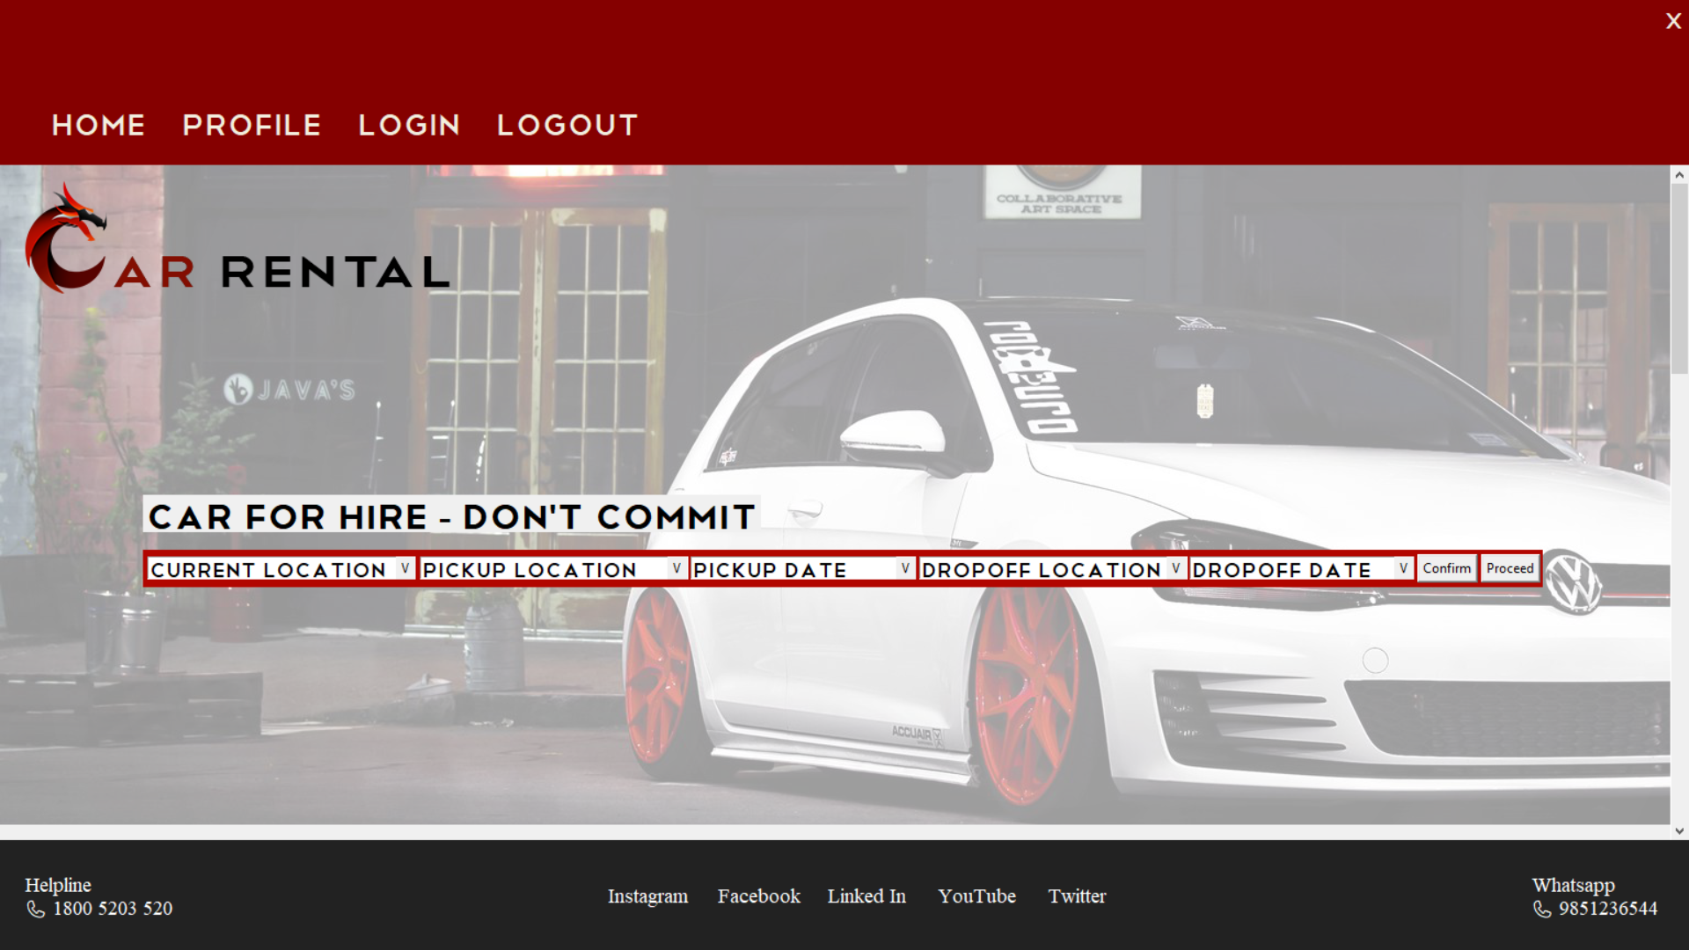

Slide 6
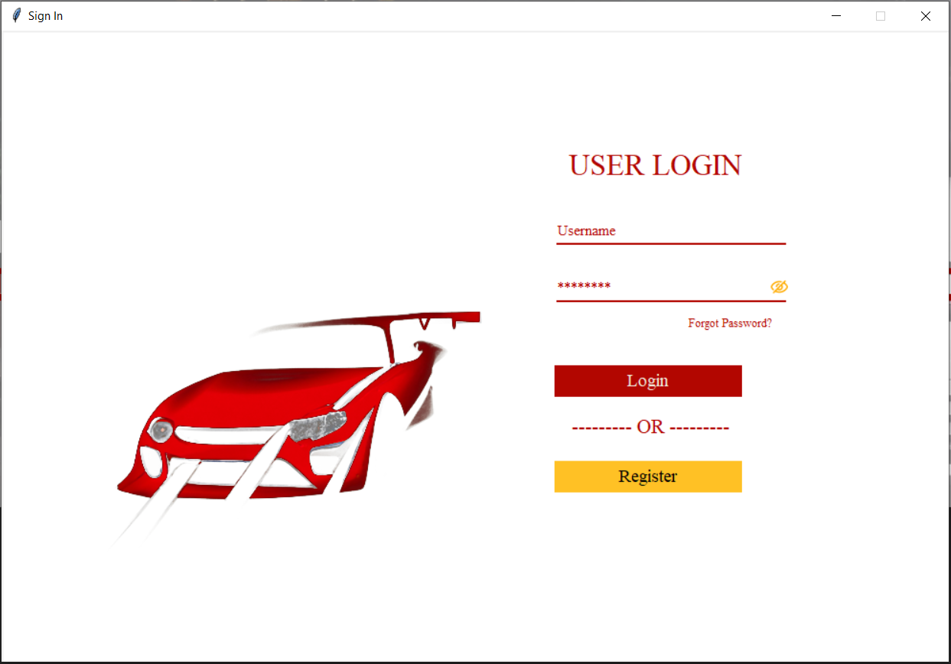
User Login Page
The user is required to sign in before he/she may book a rental car from us.
The login page is where a user can sign into their account and start the booking process.
This is also the page that allows a user to register as a new customer.
Which also allows the customer to reset their password in case they have forgotten theirs.

Slide 7
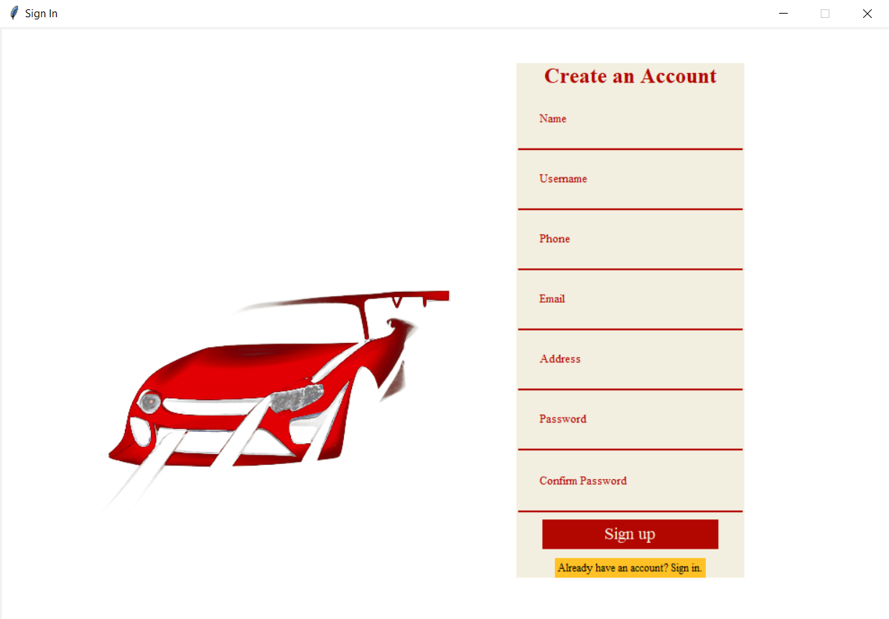
Registration
The Register button leads the user to the page in the picture.
Here, the user is required to fill in his/her personal details such as name, phone number, address and more before he/she may register.
This page also allows the user to return to the main User login page by pressing the “Already have an account? Sign in” button.

Slide 8
Tables
Customer table:
Login table:
Customer_name | Username | Customer_EMail | Customer_Address | Customer_phone | Customer_password
Username | Password

Slide 9
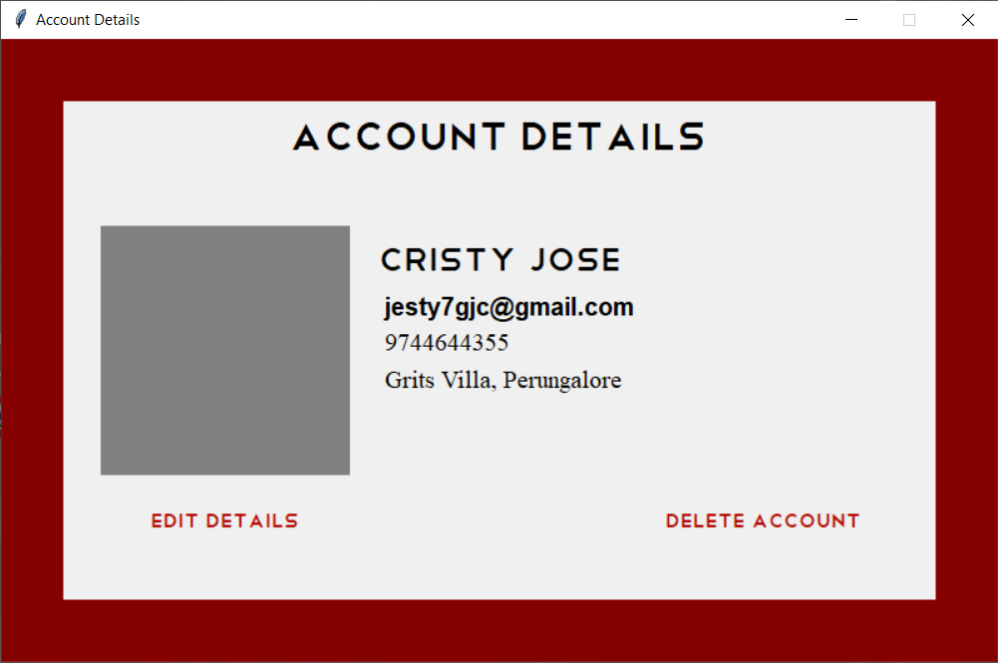
Account Details
This is a users information window.
The Profile button on the home page will lead the user to this window.
Here the user have 2 buttons which are Edit Details and Delete Account

Slide 10
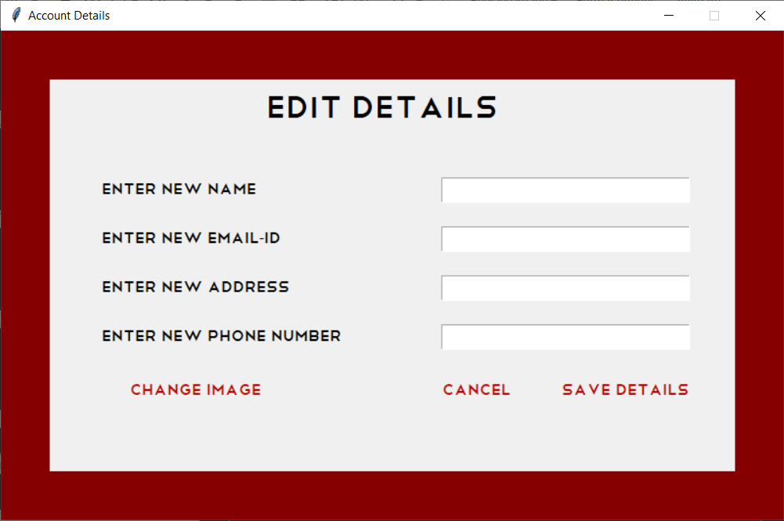
Edit Details
When the user click on Edit Details button it will open a editing window as show in the picture.
This window allows the user to change their details such as name, image, email-id, address and phone number.
When the user entered the all the new details and clicked on Save Details button will update all the new details .
And also Cancel button returns to the previous window

Slide 11
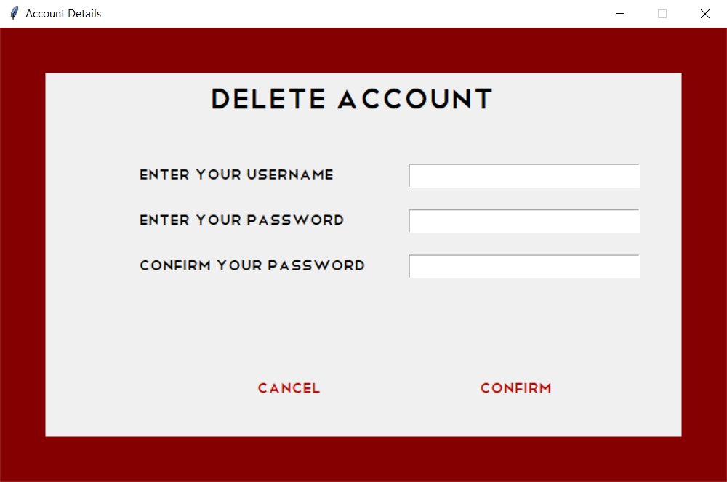
Delete Account
This window allows the user to delete their account permanently
Here the user required to enter the username with corresponding password.
When the user enter the required details and clicked on confirm button will delete the account

Slide 12
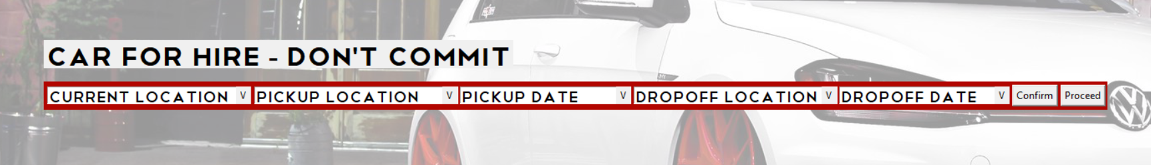
Booking a Car
The booking for a car is done using this frame.
A user is required to provide all the details asked in the above boxes in order to continue with the process.
Then the user must confirm their booking and then proceed. Which will take the user to the car selection.

Slide 13
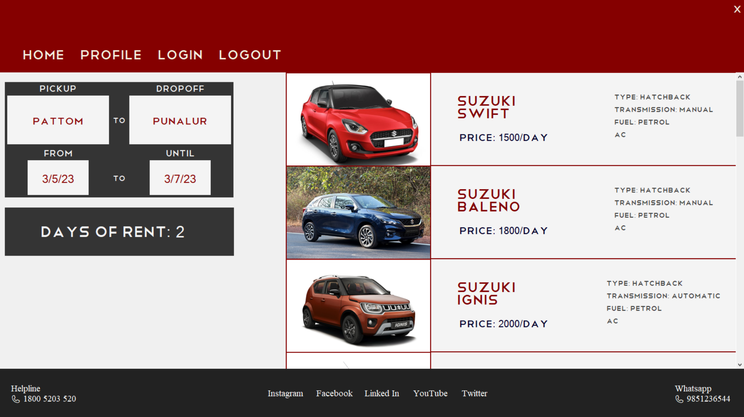
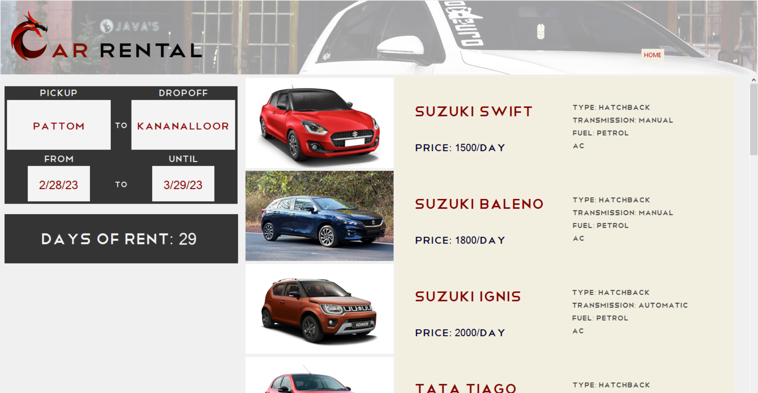
Click here to select Car
Booking details

Slide 14
Car Selection
We have vehicles from a variety of specs for the user.
There are SUVs, sedans and hatchbacks
Each car has its own characteristics which are shown alongside each car.
Furthermore, a much detailed description of the vehicle will be available once you choose the car.
However, if the user is not satisfied with his/her choice, they may return and choose another car to rent.
Once the car has been chosen the user may proceed to confirm and complete the payment.
Along with the details, instructions for receiving the vehicle have also been included for ease.

Slide 15
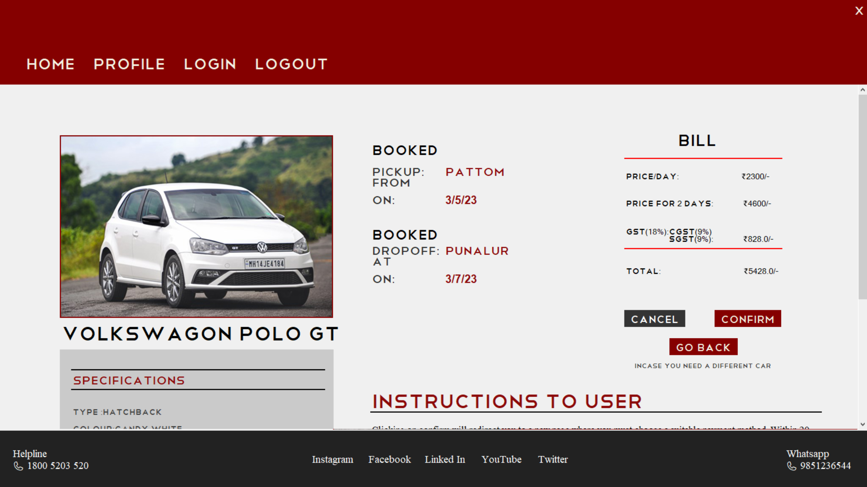
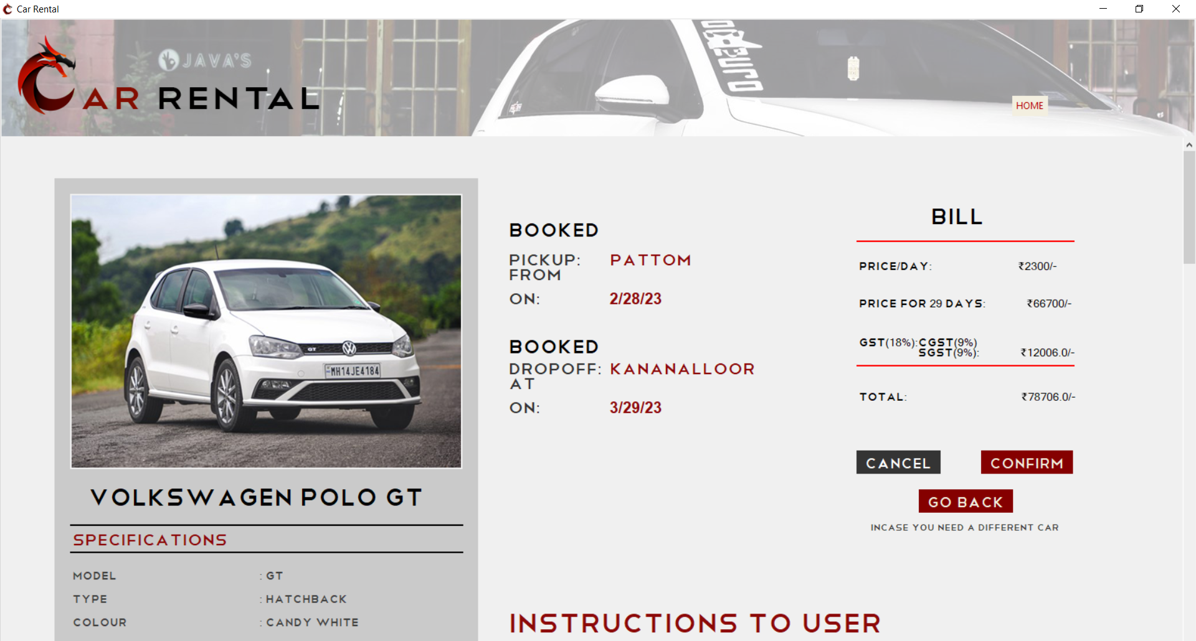

Slide 16
Booking tables
Booking Details table:
Car Details:
Temp_booking table:
Month | Date | Time | Pickup date | Pickup location | Drop Off date | Drop Off location | Username | Car_name | Cost
Car_name | type | colour | transmission | Fuel | Mileage | Seats | AC | Infotainment | Fog Lamps
Month | Date | Time | Pickup date | Pickup location | Drop Off date | Drop Off location | Username | Car_name | Cost

Slide 17
Modules Used
from tkinter import *
from tkinter import ttk, messagebox
import mysql.connector
from datetime import datetime
from tkcalendar import Calendar
from PIL import ImageTk, Image
import pymysql

